Slide 1
1
Hadoop Streaming

Slide 2
2
Outline
Brief Introduction to HDFS
Hadoop Streaming
Word Count
Exercises

Slide 3
3
HDFS Concepts
HDFS is a filesystem designed for storing very large files with streaming data access patterns, running on clusters of commodity hardware.

Slide 4
4
HDFS Concepts
“Very large” in this context means files that are hundreds of megabytes, gigabytes, or terabytes in size. There are Hadoop clusters running today that store petabytes of data.
Streaming data access : HDFS is built around the idea that the most efficient data processing pattern is a write-once, read-many-times pattern.
Commodity hardware : Hadoop doesn’t require expensive, highly reliable hardware to run on.

Slide 5
5
Basic Filesystem Operations
To create a directory:
% hadoop fs -mkdir tempinput
我hadoop@Chris-ubuntu:/usr/local/hadoop$ bin/hadoop fs -mkdir /tempinput
To display an HDFS file listing:
% hadoop fs –ls
我hadoop@Chris-ubuntu:/usr/local/hadoop$ bin/hadoop fs -ls
Found 2 items
drwxr-xr-x - tom supergroup 0 2012-10-20 22:41 /user/hadoop/tempinput
-rw-r--r-- 1 tom supergroup 118 2012-10-20 22:29 /user/hadoop/tempoutput

Slide 6
6
Basic Filesystem Operations
copying a file from the local filesystem to HDFS:
hadoop fs -copyFromLocal input/test1.txt hdfs://localhost/user/hadoop/tempinput/test1.txt
我hadoop@Chris-ubuntu:/usr/local/hadoop$ bin/hadoop fs -copyFromLocal /home/experiment/input/test1.txt hdfs://localhost:9000/usr/local/hadoop/tempinput/text1.txt（9000是为了限制端口，否则默认端口为8020）

Slide 7
7
Basic Filesystem Operations
Let’s copy the file back to the local filesystem and check whether it’s the same:
% hadoop fs -copyToLocal test1.txt test1.copy.txt
我试的时候是hadoop@Chris-ubuntu:/usr/local/hadoop$ sudo bin/hadoop fs -copyToLocal hdfs://localhost:9000/usr/local/hadoop/tempinput/text1.txt /home/experiment/input/test1copy.txt
% md5 input/test1.txt test1.copy.txt
我的是hadoop@Chris-ubuntu:/usr/local/hadoop$ md5sum /home/experiment/input/test1copy.txt /home/experiment/input/test1.txt
MD5 (input/test1.txt) = a16f231da6b05e2ba7a339320e7dacd9
MD5 (test1.copy.txt) = a16f231da6b05e2ba7a339320e7dacd9

Slide 8
8
Basic Filesystem Operations
To delete a directory:
% hadoop fs -rmr /user/hadoop/tempinput

Slide 9
9
Hadoop Streaming
Hadoop provides an API to MapReduce that allows you to write your map and reduce functions in languages other than Java.
In this course we mainly use python

Slide 10
10
Hadoop Streaming
WordCount AGAIN!
The “trick” behind the following Python code is that we will use HadoopStreaming for helping us passing data between our Map and Reduce code via STDIN (standard input) and STDOUT (standard output). We will simply use Python’s sys.stdin to read input data and print our own output to sys.stdout. That’s all we need to do because HadoopStreaming will take care of everything else!

Slide 11
11
Hadoop Streaming
Example mapper.py
Example reducer.py
Make sure these *.py files have execution permission with the following command:
(remember this all though this experiment)
chmod + x *.py

Slide 12
12
Mapper.py
#!/usr/bin/env python
import sys
# input comes from STDIN (standard input)
for line in sys.stdin:
# remove leading and trailing whitespace
line = line.strip()
# split the line into words
words = line.split()
# increase counters
for word in words:
# write the results to STDOUT (standard output);
# what we output here will be the input for the
# Reduce step, i.e. the input for reducer.py
#
# tab-delimited; the trivial word count is 1
print '%s\t%s' % (word, 1)

Slide 13
13
Reducer.py
#!/usr/bin/env python
from operator import itemgetter
import sys
current_word = None
current_count = 0
word = None
# input comes from STDIN
for line in sys.stdin:
# remove leading and trailing whitespace
line = line.strip()
# parse the input we got from mapper.py
word, count = line.split('\t', 1)
# convert count (currently a string) to int

Slide 14
14
Reducer.py
try:
count = int(count)
except ValueError:
# count was not a number, so silently
# ignore/discard this line
continue
# this IF-switch only works because Hadoop sorts map output
# by key (here: word) before it is passed to the reducer
if current_word == word:
current_count += count
else:
if current_word:
# write result to STDOUT
print '%s\t%s' % (current_word, current_count)
current_count = count
current_word = word
# do not forget to output the last word if needed!
if current_word == word:
print '%s\t%s' % (current_word, current_count)

Slide 15
15
Hadoop Streaming
InputSplit
ReduceTask
Output
MapTask
stdin
stdout
stdin
stdout
uMap
uReduce

Slide 16
16
Hadoop Streaming
Find some passages as your experiment’s input
Move them to /home/experiments/input

Slide 17
17
Hadoop Streaming
Write your own mapper and reducer programs in Python (sample codes are given as enclosure)
Copy them to
/home/experiments/src/mapper.py & /home/experimrnts/src/reducer.py respectively

Slide 18
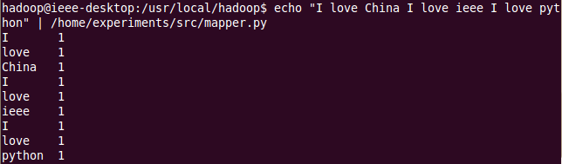
18
Hadoop Streaming
Test your code first and make sure they are correct
(cat data | map | sort | reduce)
Map
我的是echo "I love China I love ieee I love python" | sudo python /home/experiment/src/mapper.py

Slide 19
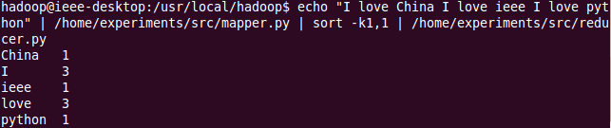
19
Hadoop Streaming
Test your code locally first and make sure they are correct
Reduce after sorting
我的是echo "I love China I love ieee I love python" | sudo python /home/experiment/src/mapper.py | sort -k1,1 | sudo python /home/experiment/src/reducer.py

Slide 20
20
Hadoop Streaming
Copy local example data to HDFS
我的hadoop@Chris-ubuntu:/usr/local/hadoop$ bin/hadoop fs -copyFromLocal /home/experiment/input/test1.txt tempinput

Slide 21


21
Hadoop Streaming
Wordcount with hadoop streaming
Map&reduce process

Slide 22
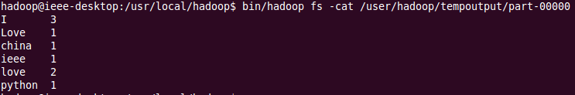
22
Hadoop Streaming
Show the results
(I changed test1.txt file so the result was not exactly the same)

Slide 23

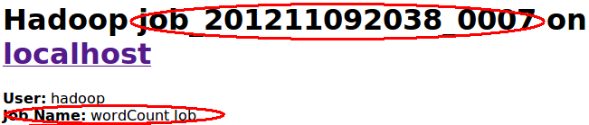
23
Hadoop Streaming
Is it boring enough to copy the command above?
What you may DIY with?
Change the MR job name with the following command: -jobconf mapred.job.name=“wordCount”

Slide 24
24
Hadoop Streaming
Mapper Only(without reducer)
command: -reducer NONE
(“NONE” all in caps)

Slide 25
25
Hadoop Streaming
Chaining jobs
Not every problem can be solved with a MapReduce program, but fewer still are those which can be solved with a single MapReduce job. Many problems can be solved with MapReduce, by writing several MapReduce steps which run in series to accomplish a goal:
Map1 -> Reduce1 -> Map2 -> Reduce2 -> Map3...
If you build up everything , such as the sorter , partitioner etc. , all by yourself, it’s quite easy to chain jobs together.
But in hadoop streaming , you need other tools’ help. In this experiment, I use bash .

Slide 26

26
Hadoop Streaming
Chaining jobs
Example: Accumulator (here I use Mapper Only mode)
(1 + 1 + 1 + 1 = ?) 1>>Map1>>Map2>>Map3>>answer
Step1
Step2
test_accumulate.txt:

Slide 27
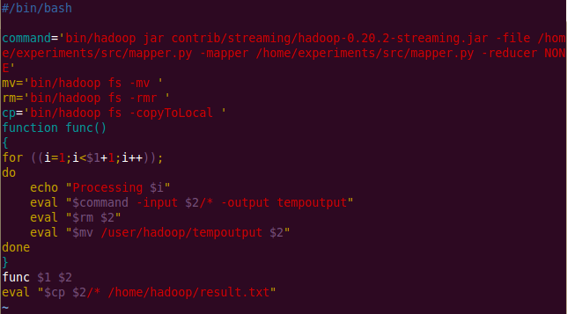
27
Hadoop Streaming
Chaining jobs
Step3 create a bash command file bash_test.sh

Slide 28
28
Hadoop Streaming
Chaining jobs
Step4

Slide 29
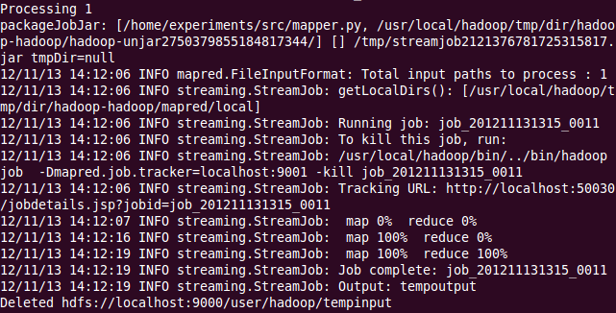
29
Hadoop Streaming
Chaining jobs
3 rounds of iterations

Slide 30
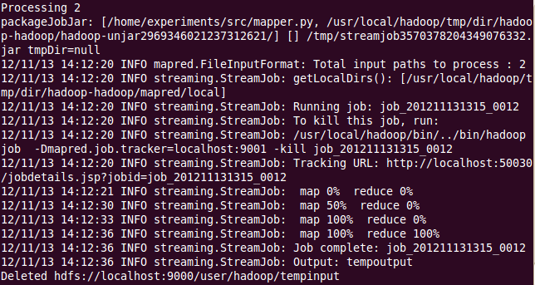
30
Hadoop Streaming
Chaining jobs
3 rounds of iterations

Slide 31
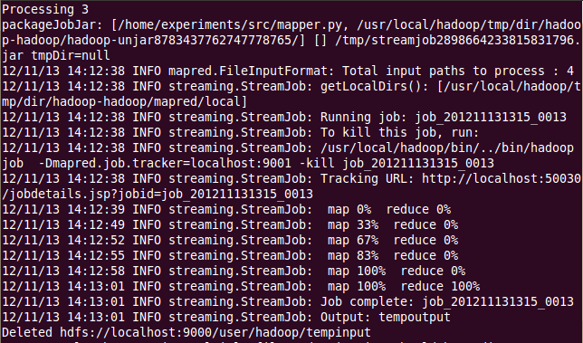
31
Hadoop Streaming
Chaining jobs
3 rounds of iterations

Slide 32
32
Hadoop Streaming
Chaining jobs
The result
*If you are interested in this part , you may learn more with a further study on oozie or programming with Java on hadoop.

Slide 33
33
exercise1
There is an English essay , try to write a mapper.py and a reducer.py to calculate the average length of each word starting from “A” to “Z”.
Eg. we become what we do
w 2.66 =[len(“we”)+len(“what”)+len(“we”)]/3
b 1
d 1

Slide 34
34
exercise2
There is a basic algorithm about PageRank in the following website: http://www.chenjunlu.com/2012/10/pagerank-on-mapreduce/
It’ll take several rounds of iterations to work out the final pagerank value. Try to write you own mapper.py and reducer.py to implement this algorithm.

Slide 35
35
exercise2
To make it easier to understand, I’ll give the following example: α = 0.85
Input: Output:
ID PR Link ID ID PR Link ID
1 1.0 2 3 4 1 0.0375 2 3 4
2 1.0 3 4 2 1.1708 3 4
3 1.0 4 3 0.7458 4
4 1.0 2 4 1.5958 2
Map&Reduce

Slide 36
36
exercise2
We’ll get the final pagerank value in this way:
Input: temp_1 temp_2
………temp_k Output
In this process , the output of the previous reducer becomes the input of the next mapper.
Map1&Reduce1
Map2&Reduce2
Mapk&Reducek

Slide 37
37
About the assignment
You may put the exercises in exp5 and exp6 together;
Zip your report, source code and test files together and rename it with a key word --“exp6”;
Hand in your assignment before the deadline : 24:00 on Nov. 23.

Slide 38
38
Thank You
Questions and Answers !!!

